Slide 1
Bio& 242:
Unit 2 / Lecture 2

Slide 2
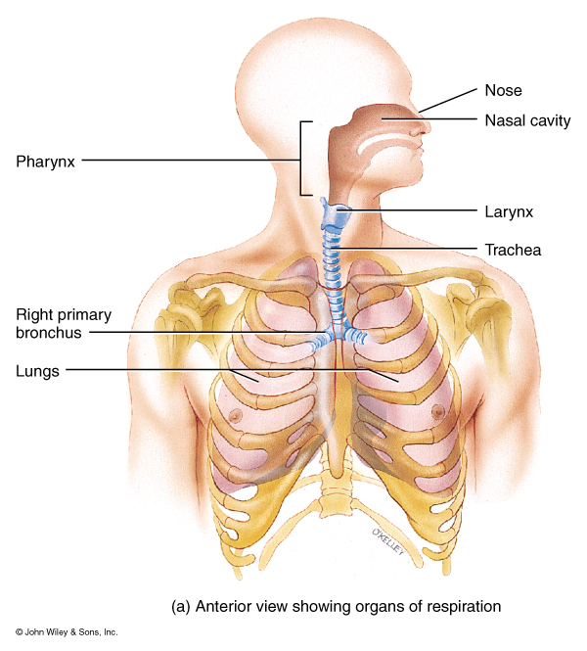
Processes of the
Respiratory System
Pulmonary ventilation
mechanical flow of air into and out of the lungs
External Respiration
exchange of gases between the pulmonary air spaces and the blood
Internal Respiration
exchange of gases between blood and tissues

Slide 3
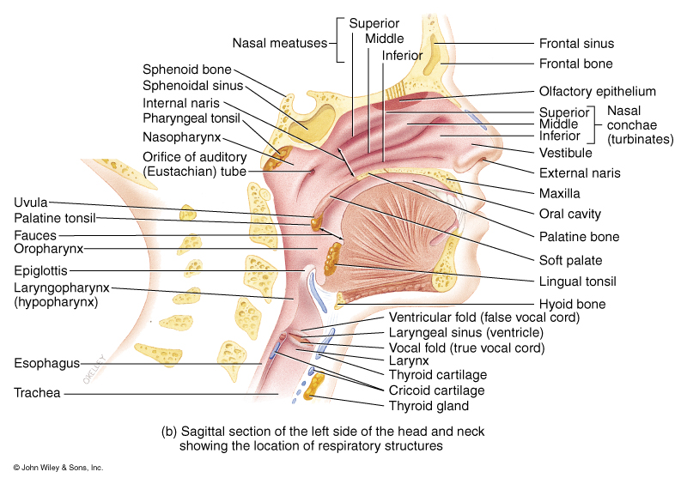
Structural Portions of the Respiratory System
Upper Respiratory System
1. warming, moistening and filtering incoming air;
2. receiving olfactory stimuli
3. serving as large, hollow resonating chambers to modify speech sounds

Slide 4
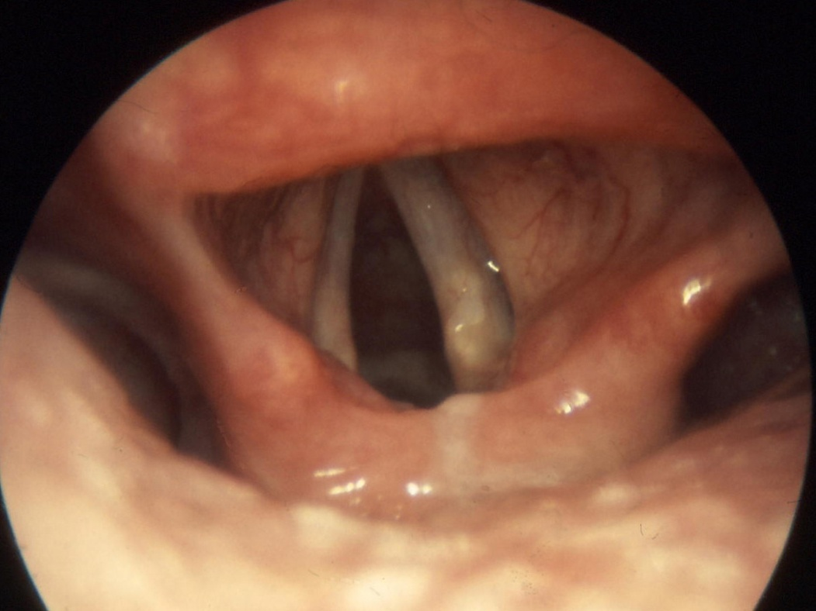
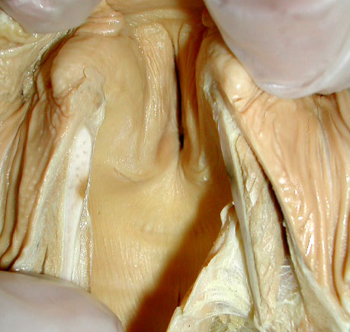
Structural Portions of the Respiratory System
LARYNX
connects the pharynx with the trachea.
Contains: the thyroid cartilage
epiglottis which prevents food from entering the larynx
cricoid cartilage which connects the larynx and trachea,
paired arytenoid, corniculate and cuneiform cartilages.
True Vocal folds
Opening between the true vocal folds called the glottis.

Slide 5
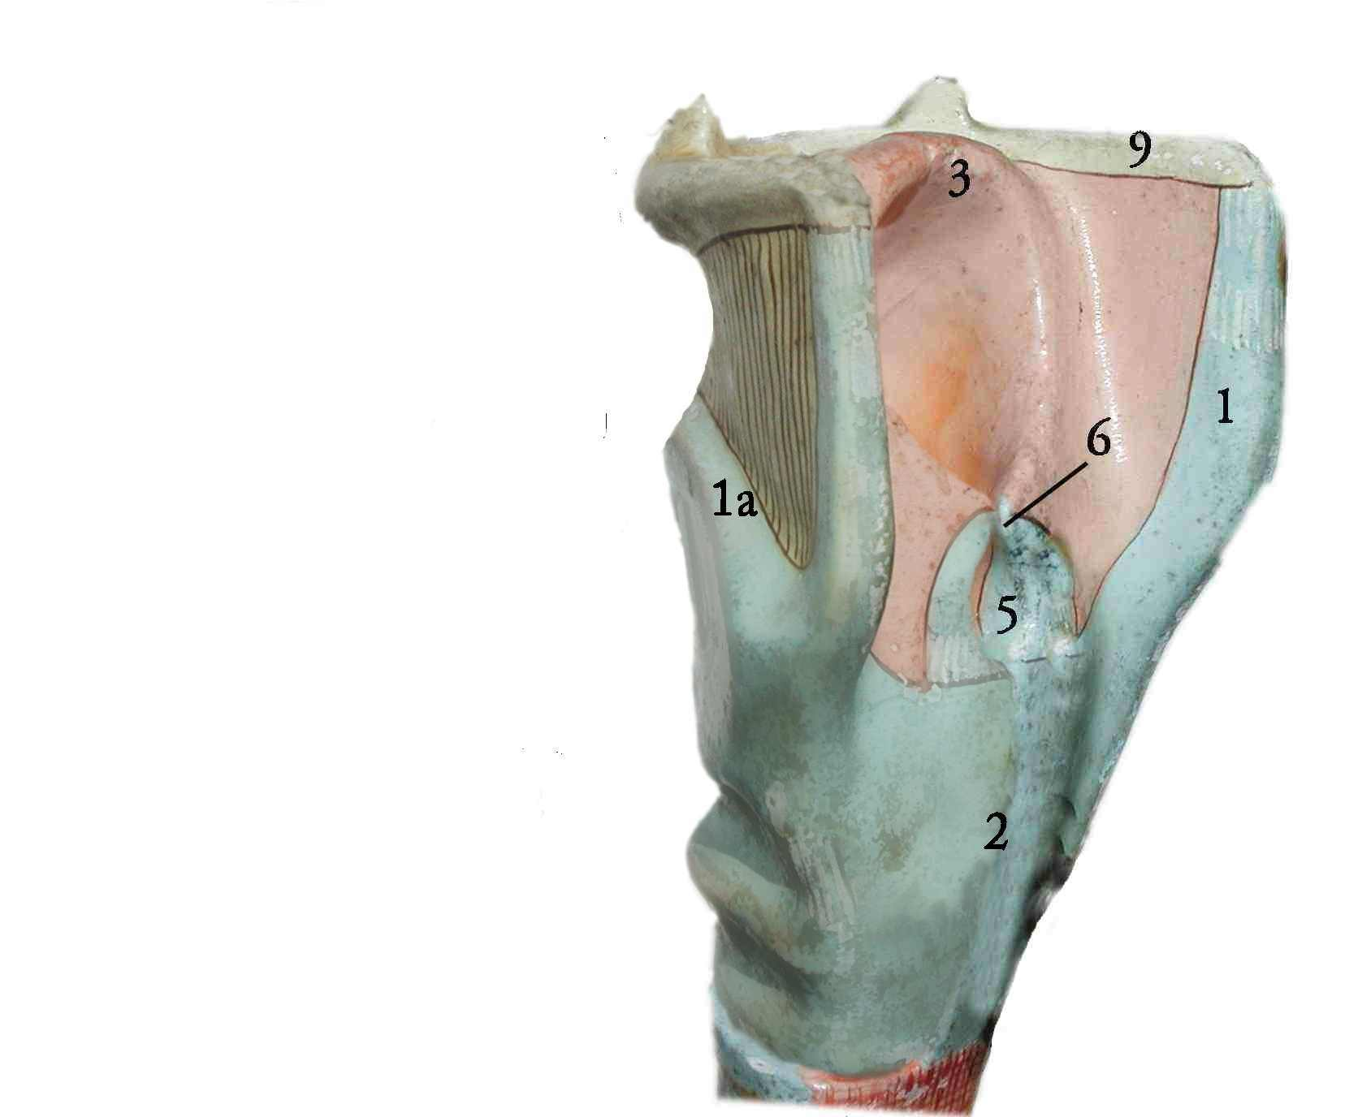
LARYNX
1. thyroid cartilage
2. cricoid cartilage
3. epiglottis
5. arytenoid cartilages
6. corniculate cartilages
9. hyoid bone

Slide 6
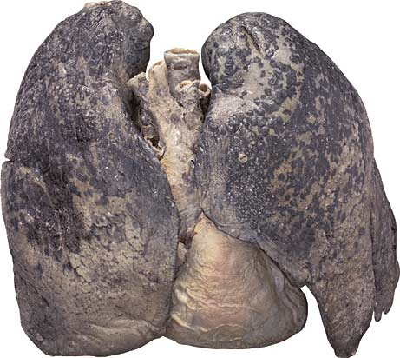
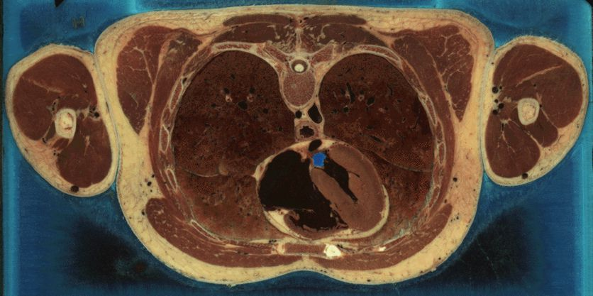
The right lung has three lobes separated by two fissures (horizontal and oblique).
The left lung has two lobes separated by one fissure (oblique) and has a depression called the cardiac notch.

Slide 7
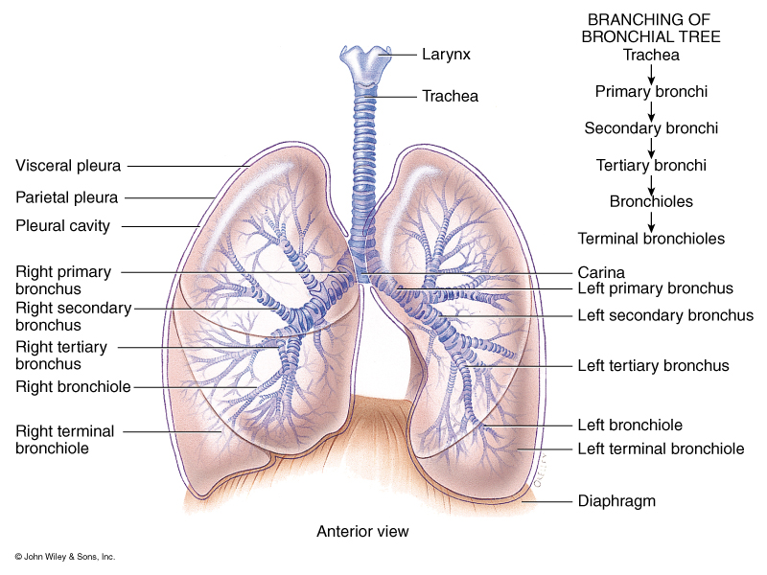
Structural Portions of the Respiratory System
Lower Respiratory System:
Contains a set of conducting ducts that carry air to the exchange surfaces.
You need to know
their order.

Slide 8
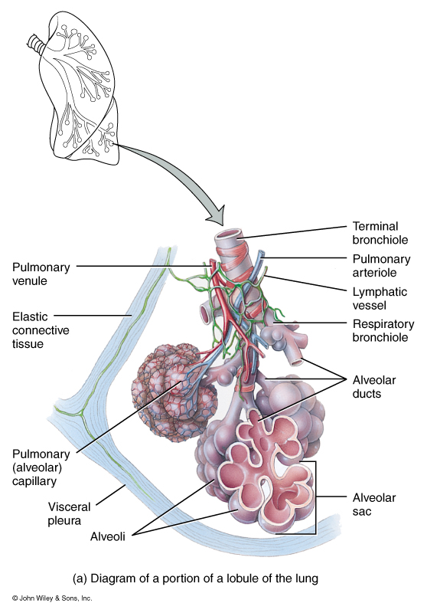
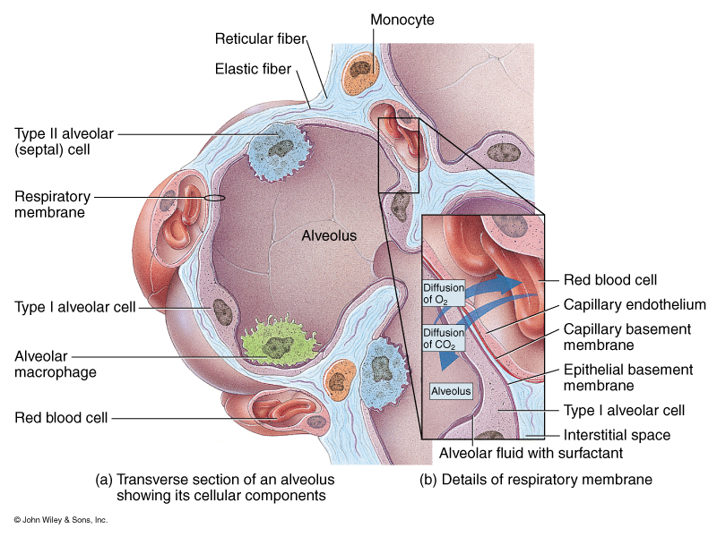
Structural Portions of the Respiratory System
Lower Respiratory System
Respiratory Portion

Slide 9
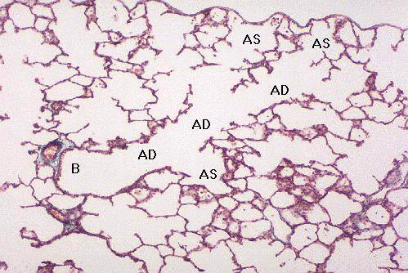
Microscopic Anatomy of a Lobule

Slide 10
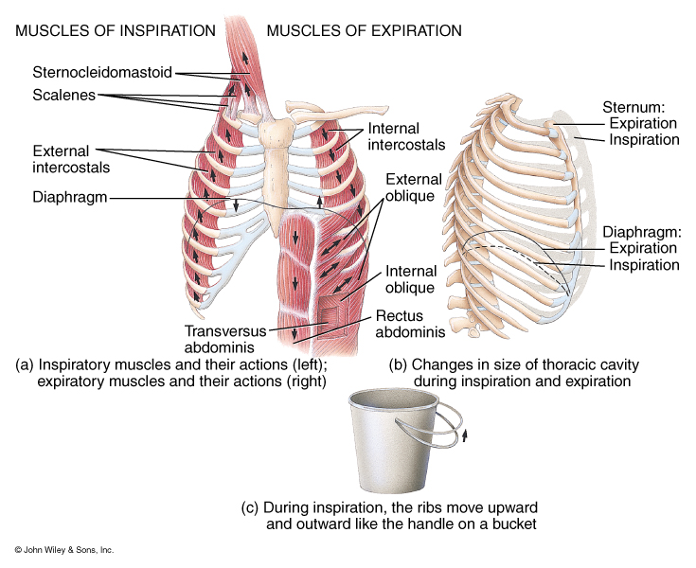
Pulmonary Ventilation
Inspiration
Muscles of Inspiration
Primary Muscle:
Diaphragm – only muscle active during normal breathing or eupnea
Secondary Muscles
Active during deep breathing
Sternocleidomastoid
Scalenes
External Intercostals

Slide 11
Pulmonary Ventilation
Expiration
Muscles of Expiration
Primary Muscle:
Diaphragm is inactive
Secondary Muscles active during deep breathing:
Internal Intercostals
External Oblique
Internal Oblique
Transversus Abdominis
Rectus Abdominis

Slide 12
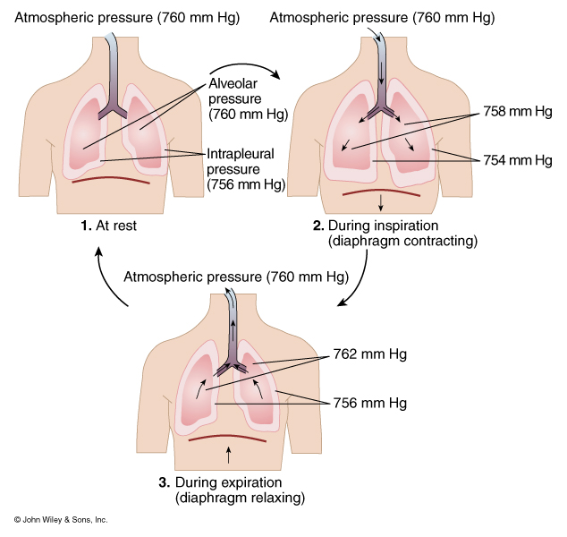
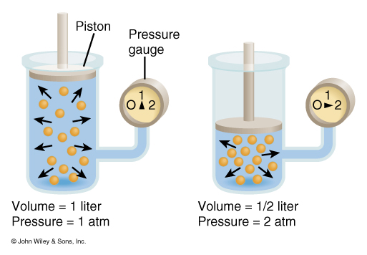
Pressure Changes in Pulmonary Ventilation and Boyle’s Law
Pressure is inversely related to Volume

Slide 13
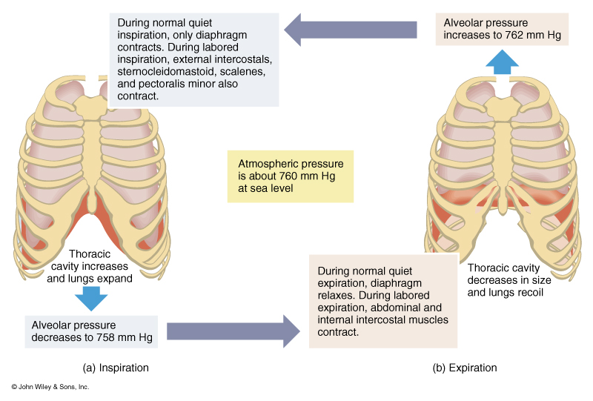
Summary of Inspiratory and Expiratory Events

Slide 14
Factors Affecting Pulmonary Ventilation
Surface Tension
Surfactant decreases surface tension thus preventing alveolar collapse
Compliance
High compliance means the lungs and thoracic wall expand easily
Low compliance means that they resist expansion

Slide 15
Factors Affecting
Pulmonary Ventilation
Decreased Compliance
Tuberculosis – scarring of the lungs
Pulmonary edema - Retention of fluid in lung tissue
Respiratory Distress Syndrome – Lack of surfactant in premature infants
Paralysis of respiratory muscles
Emphysema – destruction of elastic fibers in alveolar walls

Slide 16
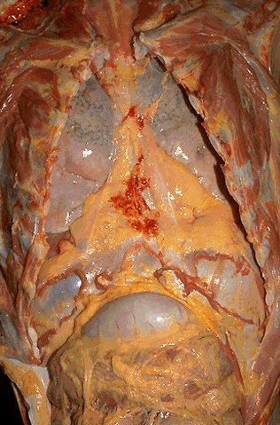

Slide 17
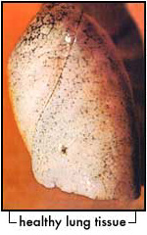
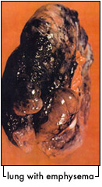

Slide 18
Factors Affecting
Pulmonary Ventilation
Airway Resistance
Any condition or obstruction of airways that increases resistance.
Chronic Obstructive Pulmonary Disease (COPD) asthma
Emphysema
Chronic Bronchitis

Slide 19
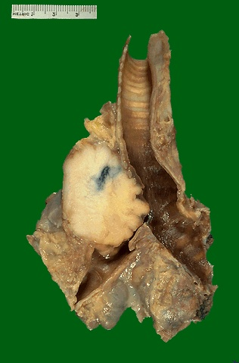
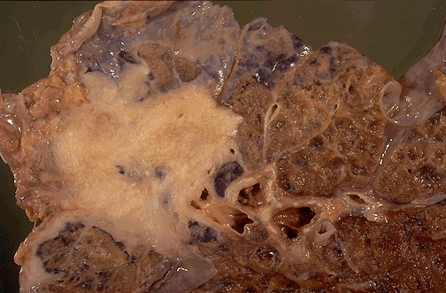

Slide 20
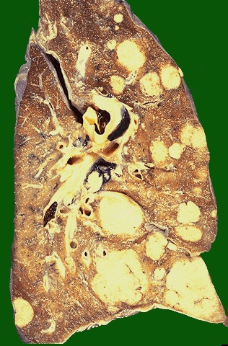

Slide 21
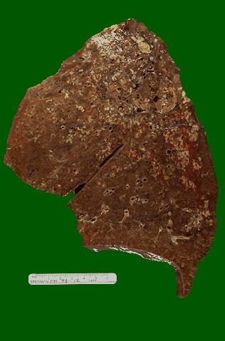
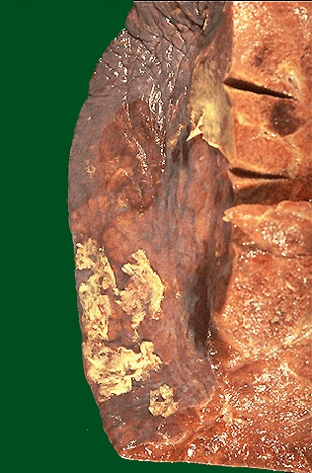

Slide 22
Smoking during pregnancy increases risk
Children whose mothers smoked during pregnancy were 2½ times more likely to have ADHD than children who weren’t parentally exposed to tobacco.
Children with blood lead levels of more than 2 micrograms per deciliter were four times more likely to have ADHD than children with levels below 0.8 microgram per deciliter. The government’s “acceptable” blood lead level is 10 micrograms per deciliter, and an estimated 310,000 U.S. children ages 1 to 5 have levels exceeding that.
Based on study estimates, more than 5 million 4-to-15-year-olds nationwide have levels higher than 2 micrograms per deciliter..
From: Exposures to Environmental toxicants and Attention deficit Hyperactivity. By Joe Braum et.al.
Environmental Heath Perspectives, Vol 114, Number 12, p 1904

Slide 23
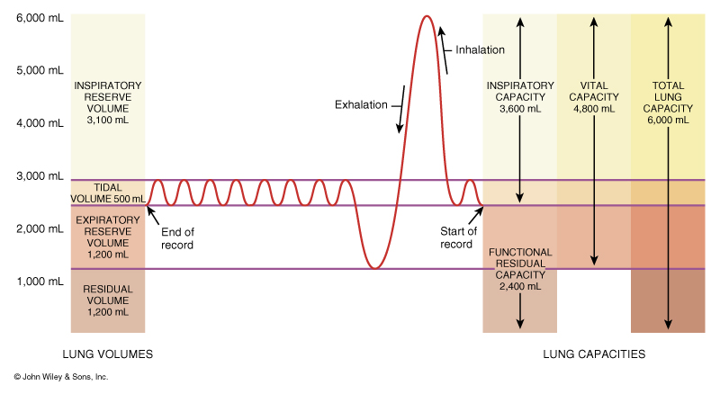
Lung Volumes and Capacities

Slide 24
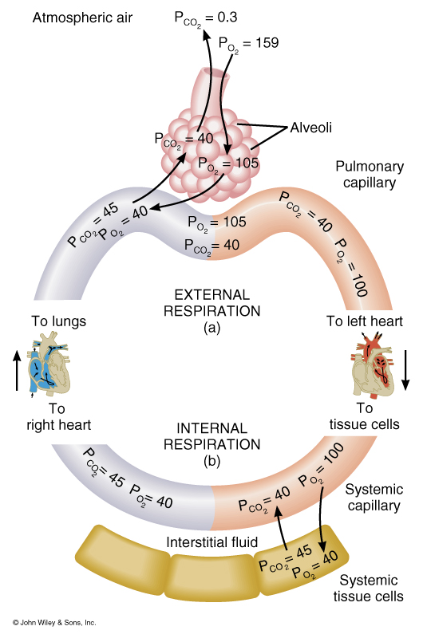
Factors Affecting External Respiration
Partial Pressure of gases
Alveolar surface area
Diffusion rate and distance
Solubility of each gas and molecular weight of the gas
Hemoglobin affinity

Slide 25
Factors Affecting External Respiration
Dalton’s Law – Atmospheric pressure is the sum total of all partial pressures of all gases in the atmosphere
N2 78% 597.4 mm Hg
02 21% 158.8 mm Hg
CO2 >1% .3 mm Hg

Slide 26
Factors Affecting External Respiration
Dalton’s Law and High Altitude Sickness
Sea Level: pO2 160 mm Hg
10,000ft.: pO2 110 mm Hg
20,000ft.: pO2 73 mm Hg
50,000ft.: pO2 18 mm Hg

Slide 27
Factors Affecting External Respiration
Henry’s Law
Quantity of a gas that will dissolve in solution is proportional to the partial pressure and the solubility coefficient (SC) of the gas.
SC CO2 = .57
SC O2 = .024
SC N2 = .012

Slide 28
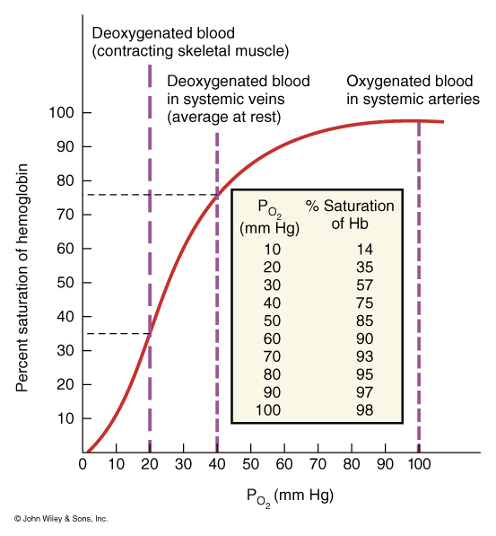
Factors that affect Oxygen Transportation by Hemoglobin
pH (blood acidity)
Partial pressure of CO2
Blood Temperature
2,3-bisphosphoglycerate
(BPG)

Slide 29
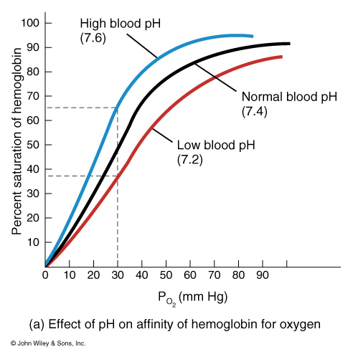
The Effect of Blood pH on the Affinity of Hemoglobin for O2
Increased pH of blood (more basic), the greater the affinity
Decreased pH of blood (more acidic), the lower the affinity

Slide 30
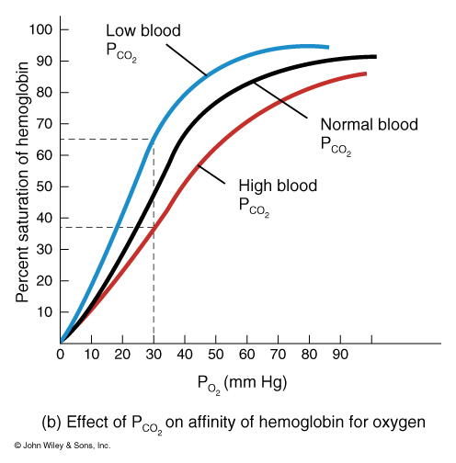
The Effect of pCO2 on the Affinity of Hemoglobin for O2
Low pCO2, the higher the affinity
High pCO2, the lower the affinity
H2O + CO2
Bohr Effect
H20 + CO2 Carbonic Acid (H2CO3) H+ + HCO3

Slide 31
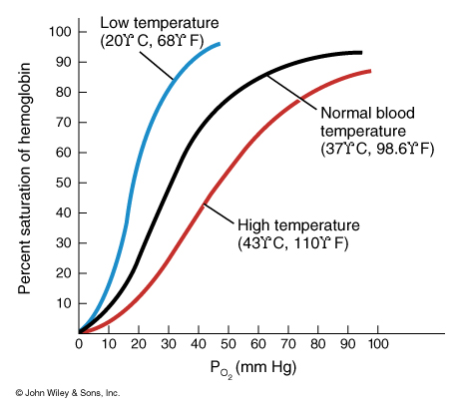
The Effect of Blood Temperature on the Affinity of Hemoglobin for O2
Lower the temperature, the greater the affinity
Higher the temperature, the lower the affinity

Slide 32
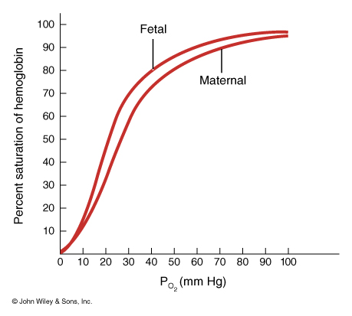
The Difference between Fetal and Maternal Hemoglobin for O2 Affinity
For efficient gas exchange between a fetus and its mother,
fetal hemoglobin has a higher affinity for O2 than maternal hemoglobin.

Slide 33
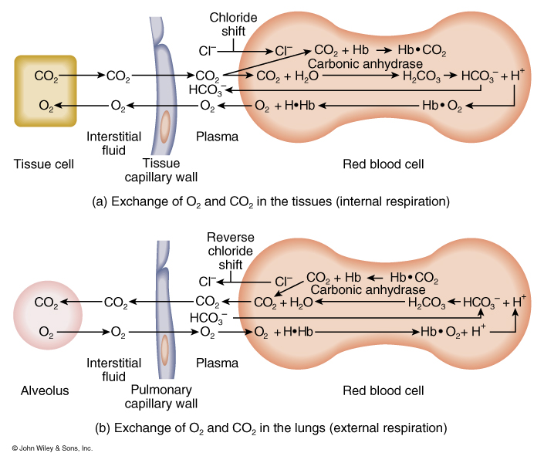
Summary of Gas Exchange during both External and Internal Respiration
O2 is carried on hemoglobin forming Oxyhemoglobin.
7% of CO2 is carried as dissolved CO2
25% of CO2 is carried as carbaminohemoglobin
70% of CO2 is carried as bicarbonate ions

Slide 34
Summary of Gas Exchange during both External and Internal Respiration
Haldane effect: The lower the oxyhemoglobin, the higher the CO2-carrying capacity of the blood.
Deoxyhemoglobin binds more readily with CO2
Deoxyhemoglobin also acts as a better buffer absorbing more H+, causing more bicarbonate to form.

Slide 35
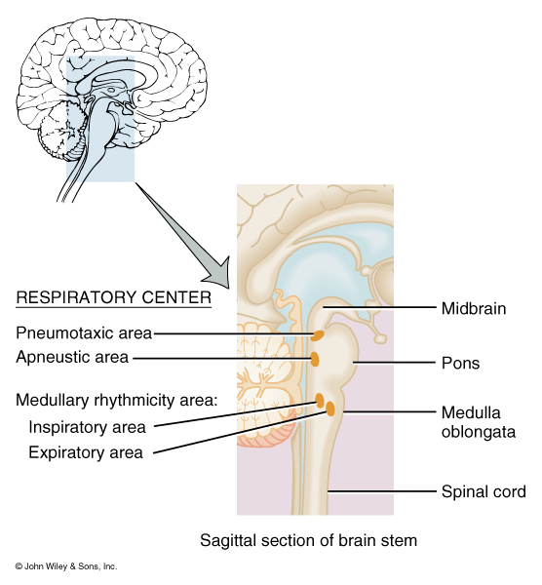
Nervous Control of Pulmonary Ventilation & the Respiratory Centers
MRA: Controls the basic rhythm of ventilation
PA: transmits inhibitory impulses to the inspiratory area
AA: Transmits stimulatory impulses to the inspiratory area

Slide 36
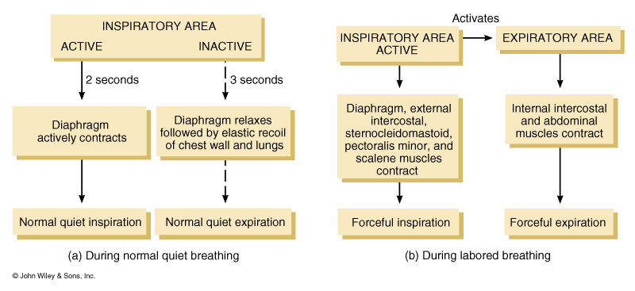
Proposed mechanism of ventilation control

Slide 37
Chemical Regulation of Respiration
Aortic Body: Cluster of chemoreceptors located in the wall of the aortic arch that respond to H+
Carotid Bodies: Cluster of chemoreceptors located in the walls of the L & R Carotid arteries that respond to H+
Central chemoreceptors: located in the Medulla Oblongata also respond to H+

Slide 38
Clinical Terms
Hypercapnia: Arterial Blood PCO2 above 40mmHg
Hypocapnia: Arterial Blood PCO2 below 40mmHg
Hyperventilation: Rapid/deep breathing
Hypoventilation: Slow/shallow breathing
Hypoxia: O2 deficiency at the tissues
Hypoxic hypoxia: Due to high altitude, airway obstruction or fluid
Anemic hypoxia: Deficiency of hemoglobin
Ischemic hypoxia: Decreased blood flow
Histotoxic hypoxia: Caused by toxic agent like cyanide which prevents tissues from using O2

